Slide 1
COVID-19 mRNA Degradation Prediction
Noor Rafiq Jefferson Pan

Slide 2
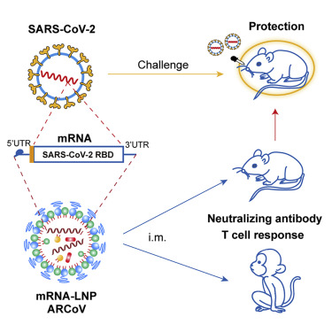
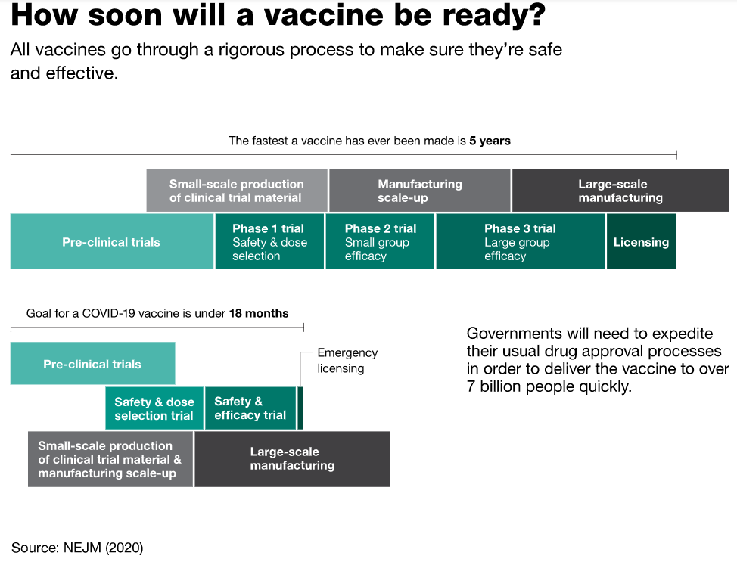
Motivation

Slide 3
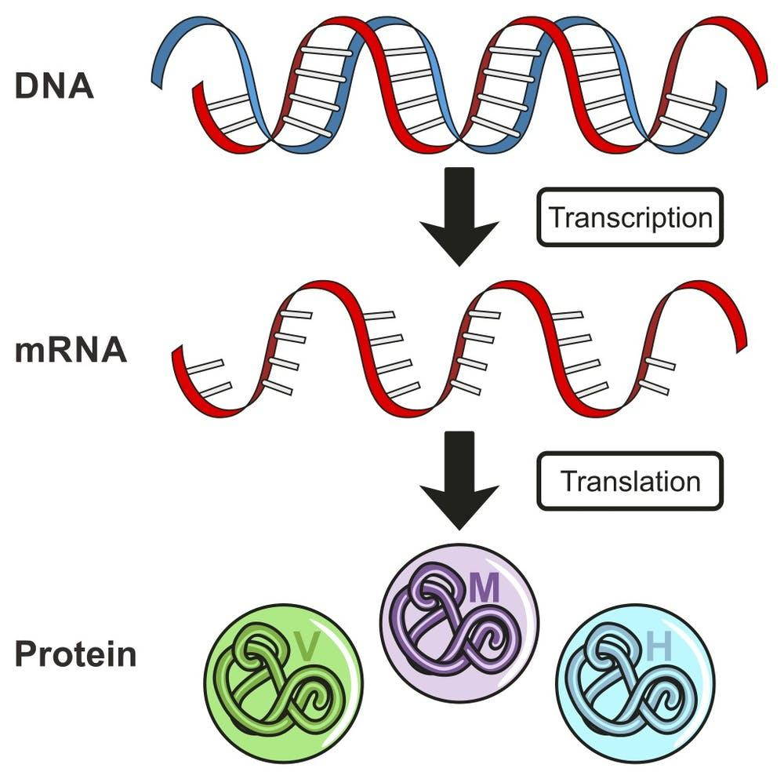
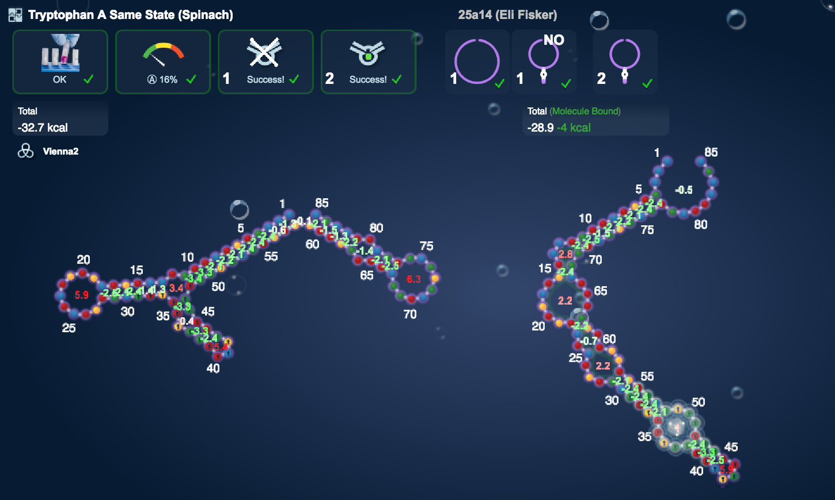
Background
What is RNA?
Eterna

Slide 4


Related Work
Moderna mRNA vaccine in stage 3 of clinical trials
Cornell University LEARNA RNA design
MIT using ML to estimate effectiveness of vaccines
OpenVaccine leverages public

Slide 5
Target Task
Given RNA sequences generated by Eterna game
Predict reactivity
Training data: 1800 RNA sequences
Testing data: 600 RNA sequences
Real reactivity found by lab testing

Slide 6
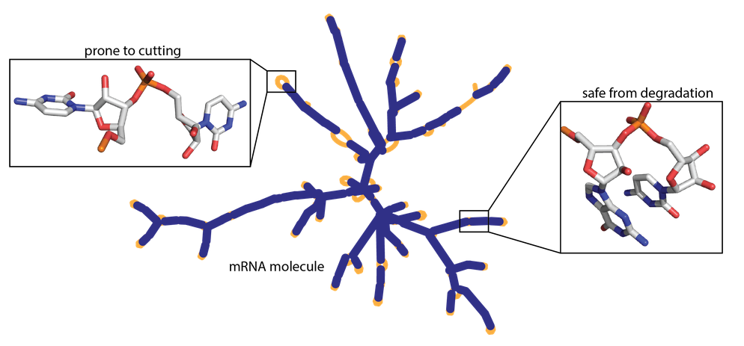
An Intuitive Figure Showing WHY needed
RNA molecules are upwards of 200 nucleotides long.

Slide 7
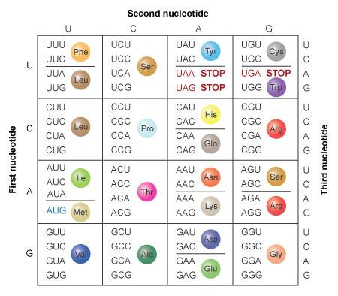
Proposed Solution: kNN
Reactivity dependent on sequence and structure
kNN for regression
Evolution of model through different approaches
Hamming distance on sequence and structure
k-Mer frequency and clustering
Euclidean distance on frequency of codons

Slide 8
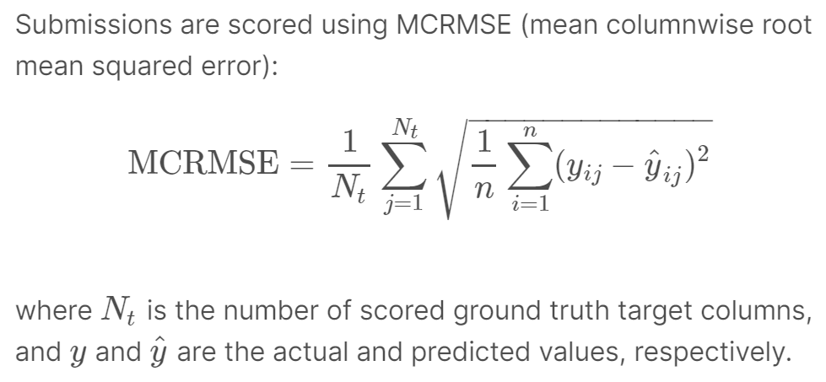
kNN Approach
Split given training set into train and test sets
Process features
Compute kNN for each test point
Predict reactivity based on average of KNN reactivity values

Slide 9
Distance Function - Hamming Distance
Sequence A: GAUCAAGAUCGAUG
Sequence B: GAACAAGCGCAAUG
Hamming Distance between A and B: 4

Slide 10
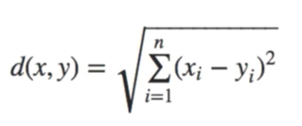
Distance Function - k-Mer Frequency
Sequence A: GAUCAAGAUCGAUG
Sequence B: GAACAAGCGCAAUG
K-mer Freq. for A
K-mer Freq. for B
GAU | 3
GCG | 0
CAA | 2
AUG | 1
... | ...
GAU | 0
UCA | 1
CAA | 1
AUG | 1
... | ...

Slide 11
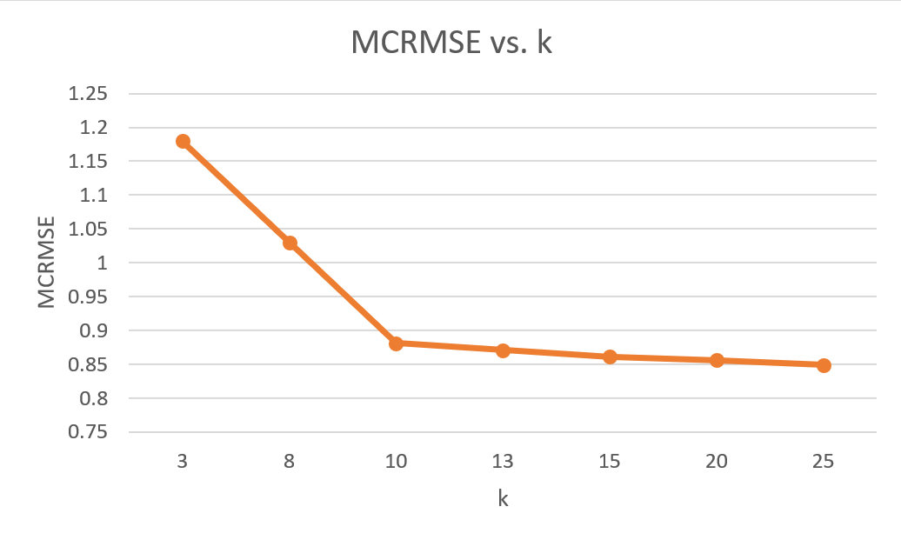
Experimental Results
k | MCRMSE
3 | 1.18
8 | 1.03
10 | .881
13 | .871
15 | .861
20 | .856
25 | .849

Slide 12
Experimental Analysis
Increasing k helps to a point
K-mers encoding may be ineffective for clustering
KNN regression may be unsuited for this task due to wide range of test data
Some reactivities are in thousands, others are less than one

Slide 13
Conclusion and Future Work
Explore other preprocessing to convert sequence to categorical data
Add majority vote to k-mer KNN-Regression
K-mer preprocessing with more traditional regression (ie logistic)
Feature weighting

Slide 14
Sources
https://www.frontiersin.org/articles/10.3389/fimmu.2019.00594/full
https://www.cell.com/cell/pdf/S0092-8674(20)30932-6.pdf
https://www.nature.com/scitable/topicpage/translation-dna-to-mrna-to-protein-393/#:~:text=Each%20group%20of%20three%20bases,acids%20that%20form%20a%20protein.
https://aip.scitation.org/doi/pdf/10.1063/1.4991238

